Slide 1

3/22/18
Implementing a High-Performance Computing Center
Quinn Stratton
Mentor: Dr. Ray Klump

Slide 2
Acknowledgements
Prof. Clairardin
Romeoville High School
Dr. Livingston
Dr. Schlachter
Dr. Klump
Dr. Powers
S.U.R.E.
http://www.criticalcommons.org/Members/ccManager/clips/a-recalcitrant-supercomputer-defies-its-operator-in-willy-wonka-and-the-chocolate-factory/thumbnailImage
Notes:
Explain FLOP - measure of "numbers crunched"

Slide 3
Background
CPU (Central Processing Unit) - “Brain” of computer, handles direct computations
handles one task at a time
GPU (Graphics Processing Unit) – Also handles direct computations, but contains many smaller processors
inherently parallel
More computing throughput, more FLOP/s per Watt
Parallel Computing – Computing that involves more than one processor working on the same problem in parallel

Slide 4
Speedup
Linear speedup would be ideal
Some algorithms are difficult to parallelize
Any computer system will involve latency
Generally due to slow communications

Slide 5
Methods
Cluster computing involves writing programs that run on multiple computers (nodes) in parallel
MPI (Message Passing Interface): Used to implement message-passing parallel programming model
Allows for communication between nodes
CUDA: Programming platform for developing on GPUs
Provides libraries for C, C++, Fortran, Python, etc.
Not limited to these tools in general

Slide 6
Computation and Science
Assist in numerical computation
Numerical solutions to differential equations, etc.
Monte Carlo Simulation
Model random processes
Machine Learning
Statistical inference from large data sets
Computational Biology
Human Genome Project

Slide 7
Goals/Motivation
Implement small-scale clusters from a low-level
Computation is playing a greater and greater role in science
Bring this power to Lewis

Slide 8
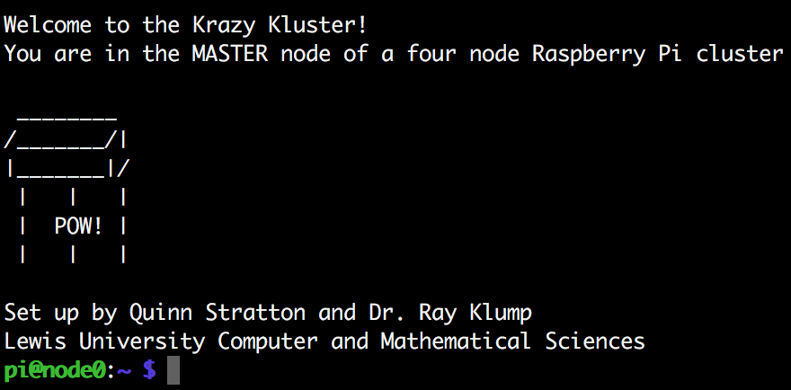
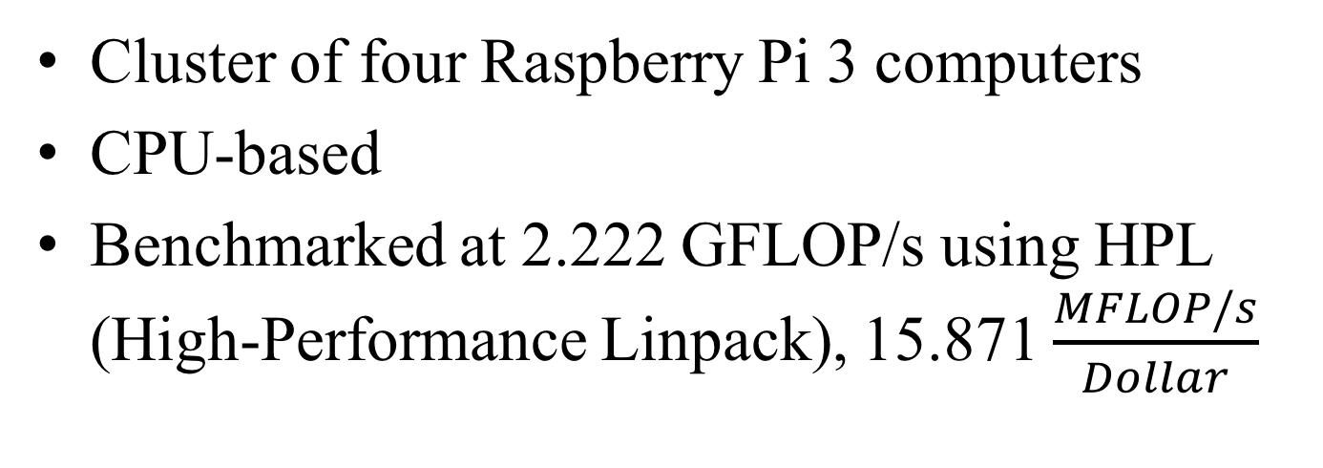
Raspberry Pi 3 Cluster
Cluster of four Raspberry Pi 3 computers
CPU-based
Benchmarked at 2.222 GFLOP/s using HPL (High-Performance Linpack), 15.871 $\frac{MFLOP/s}{Dollar}$
https://www.raspberrypi.org/app/uploads/2015/08/raspberry-pi-logo.png

Slide 9
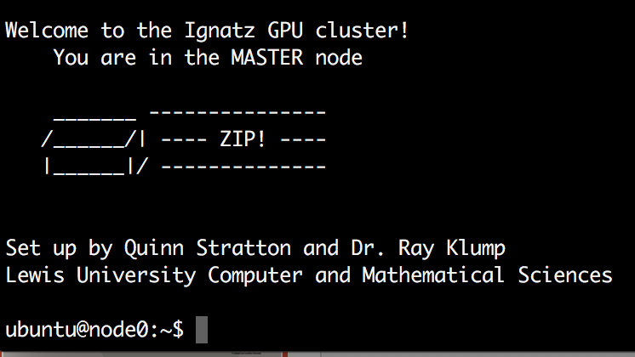
Jetson TK1 Cluster
Cluster of four Jetson TK1 computers
Each node has a CPU and a GPU with 192 cores
Notes:
Emphasize number of nodes,
MORE PARALLEL

Slide 10
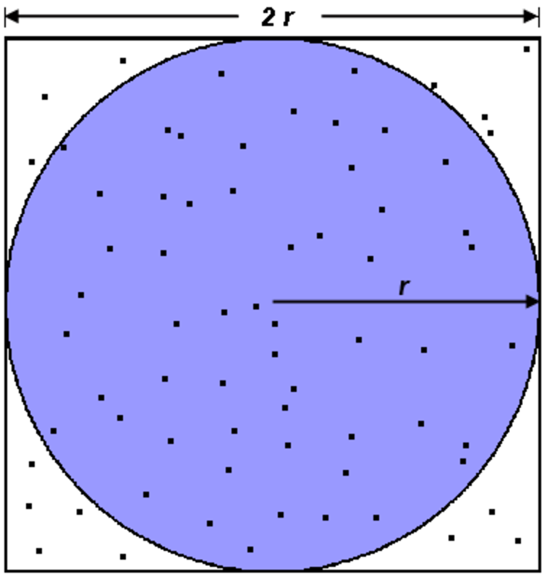
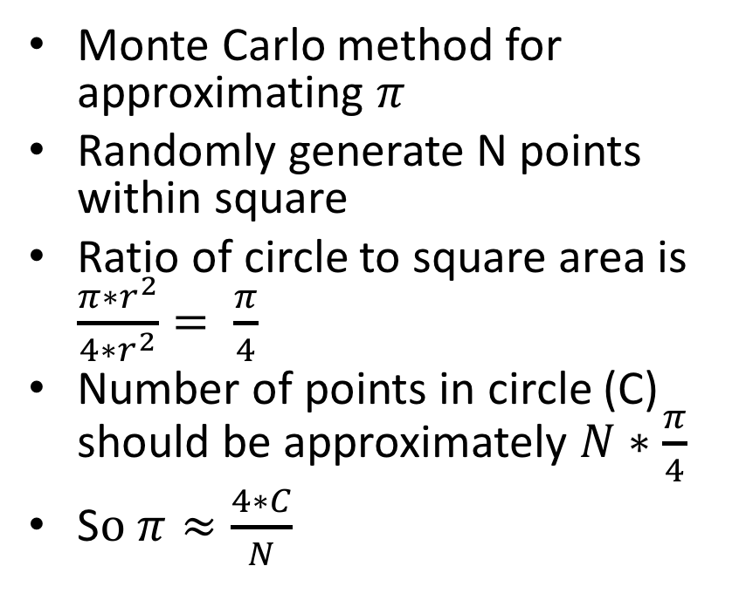
Case Study: pi_approx
Monte Carlo method for approximating $π$
Randomly generate N points within square
Ratio of circle to square area is $\frac{π∗r^{2}}{4{∗r}^{2}}= \frac{π}{4}$
Number of points in circle (C) should be approximately $N∗\frac{π}{4}$
S$o π≈\frac{4∗C}{N}$
Notes:
Connect to more complicated Monte Carlo simulation

Slide 11
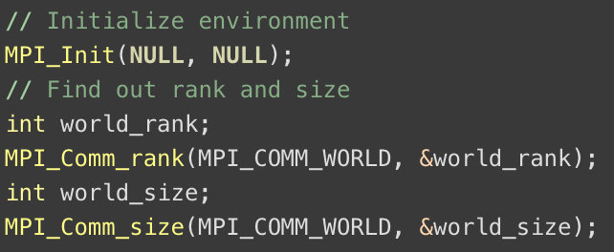
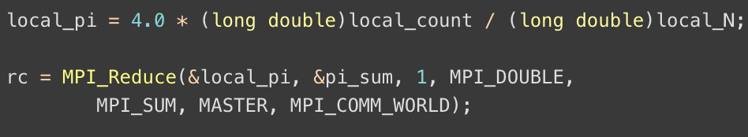
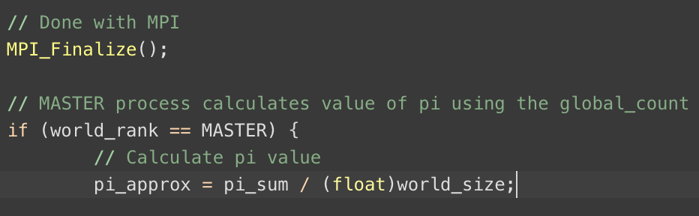
MPI only

Slide 12
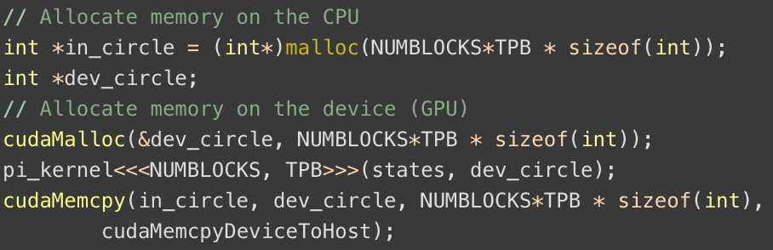
MPI with CUDA
MPI handles splitting task up among nodes
Each node now uses a GPU instead of CPU for processing

Slide 13
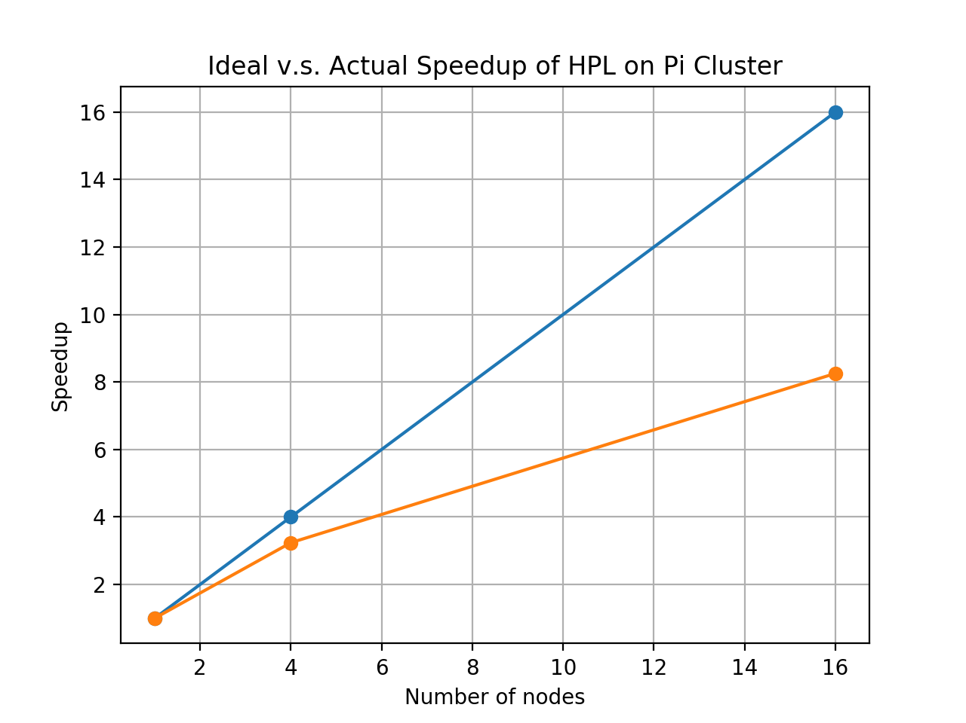
Speedup of HPL on Raspberry Pi cluster

Slide 14
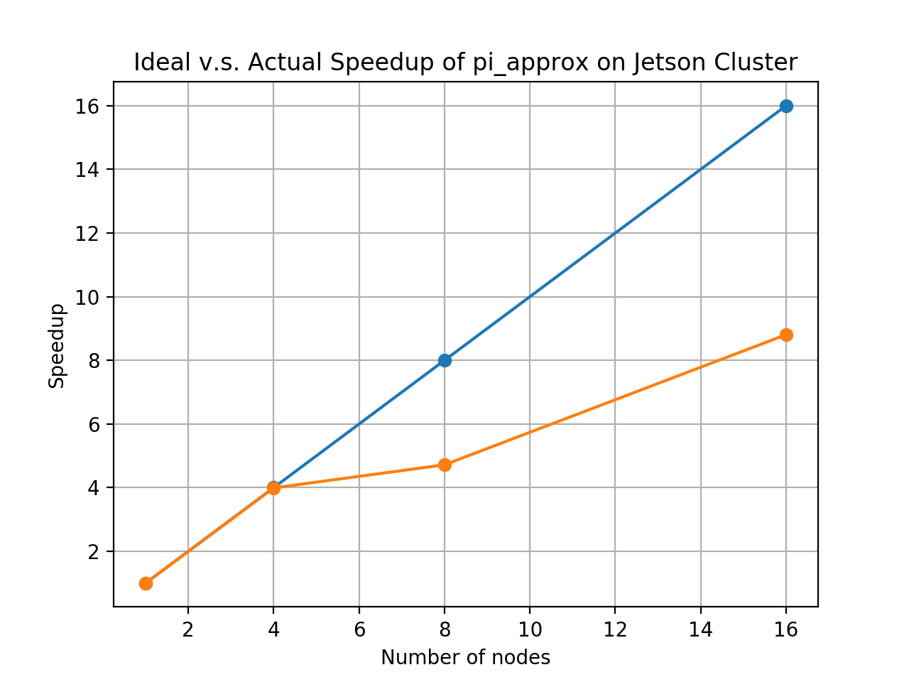
Speedup of pi_approx on Raspberry Pi Cluster

Slide 15
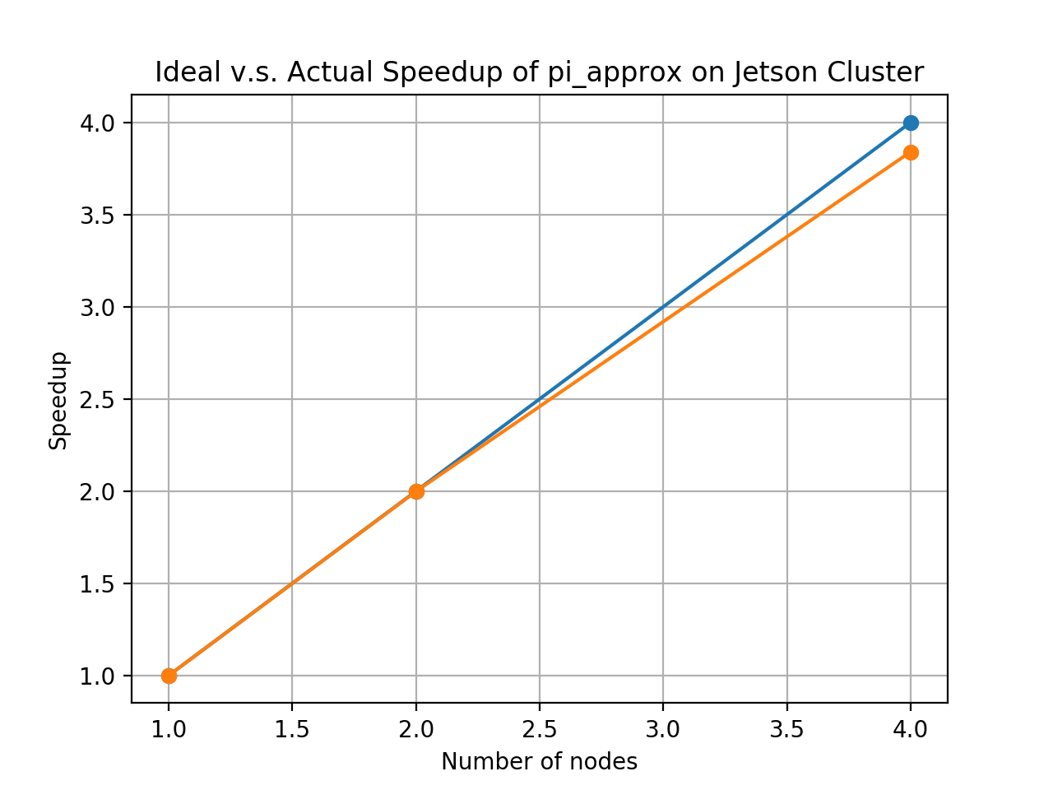
Speedup of pi_approx on Jetson TK1 Cluster

Slide 16
Further Inquiry
Compare data to official Lewis University supercomputer
TX2 Array Server
24x NVIDIA Jetson TX2
GPU: 1 TFLOP/s 256-core with NVIDIA Pascal Architecture
CPU: 4x 64-bit ARM A57 CPUs + 2 NVIDIA Denver CPUs
Memory: 8GB LPDDR4
Storage: 32 GB eMMC

Slide 17
Even Further Inquiry
Explore different programming models for high-performance computing
Python
Matlab
Functional languages
Collaboration outside of Computer and Mathematical Sciences

Slide 18
Takeaways
Intersection of computation and science is a major aspect of current research across disciplines
Important to be familiar with these methods
Allows for very interesting opportunities for interdisciplinary study and collaboration

Slide 19
Appendix
Code, data, and documents
https://github.com/drVulter/Supercomputer2017

Slide 20
References
http://www.netlib.org/benchmark/hpl/
https://www.top500.org/
https://portal.tacc.utexas.edu/c/document_library/get_file?uuid=e05d457a-0fbf-424b-87ce-c96fc0077099&groupId=13601
http://www.instructables.com/id/How-to-Make-a-Raspberry-Pi-SuperComputer/
https://blogs.nvidia.com/blog/2012/09/10/what-is-cuda-2/
https://computing.llnl.gov/tutorials/mpi/

